Slide 1
Federated Learning in V2X Communications for Side-link Enhancement
Junjie Wu
2021.12.31

Slide 2
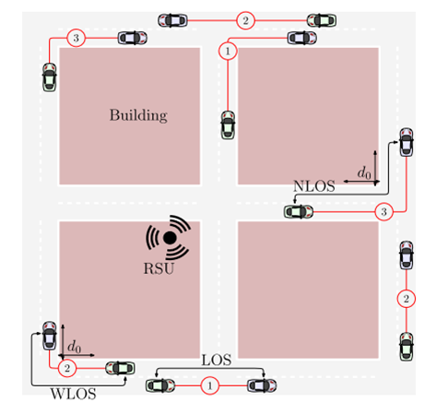
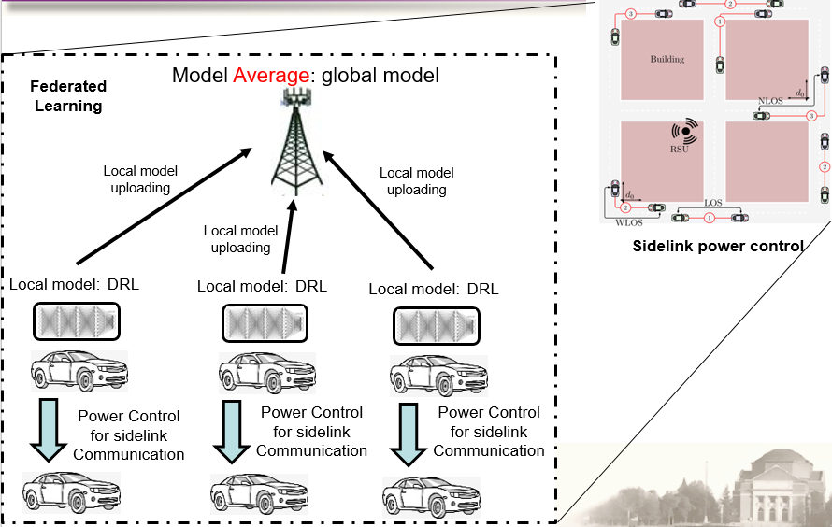
Federated Learning in V2X Communications for Side-link Enhancement
Scenario，Problem & Proposal
Scenario:
We consider the scenario of federated learning in V2X communications. The vehicles that demand the same AI model shall participate in federated learning through wireless communications in order to train an accurate global model. We focus on the side-link enhancement and further consider the use case of power control where deep reinforcement learning (DRL) is applied to minimize average power consumption of data transmission while satisfying delay constraint.
Figure. 2 System diagram of federated learning in V2X communications.
Figure. 1 Side-link communication in V2X.

Slide 3
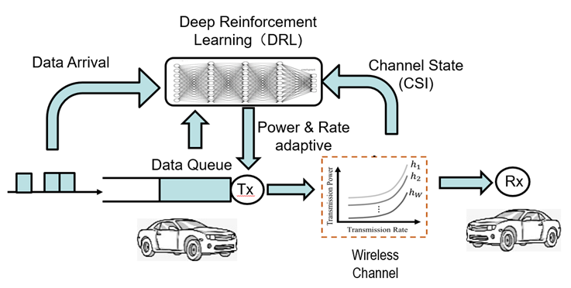
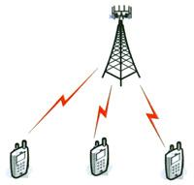


Federated Learning in V2X Communications for Side-link Enhancement
Scenario，Problem & Proposal
Scenario, Problem& Topics
Problem:
For vehicles lacking consensus of environment (similarity of dataset), the model quality may be reduced due to aggregation process with the risk of adding irrelevant data samples, especially for reinforcement learning which requires a feedback from the dynamic environment. What’s more, the performance of federated learning suffers from the “straggler”. Therefore, how to group FL users and allocate resources becomes a major problem, especially for federated training of DRL based side-link power control.
Proposal:
The vehicles upload their sidelink information in addition to assistance information such as location, uplink channel state, etc. to gNB. The gNB decides the training group based on the sidelink information and allocate resources based on assistance information.
Far User
Transmitter
(SCMA)
FL
FL
Near User
Far codeword
decoder
Far codeword
interference
cancellation
Grouping 1
Near codeword
decoder
Grouping 2
Figure. 3 DRL based side-link power control in V2X.
Figure. 4 Schematic diagram of FL grouping.

Slide 4
Specification from the 3GPP
1. SA Plenary 94#E Work Item: 5G System Support for AI/ML-based Services (SP-211613, approved):
Objective 3 (WT#1.3): Study whether and how 5GS provides assistance to AF and the UE for the AF and UE to manage the FL operation and model distribution/redistribution (i.e. FL members selection, group performance monitoring, adequate network resources allocation and guarantee.) to facilitate collaborative Application AI/ML based Federated Learning operation between the application clients running on the UEs and the Application Servers.).
2. TS 22.186 Enhancement of 3GPP support for V2X Scenario
[R.5.1-002] The 3GPP system shall be able to optimize the communication between UEs supporting V2X application belonging to the same group and in proximity.
[R.5.1-009] The 3GPP system shall support efficient coordination of radio resources used for transport of messages to maximize the utilization of the available spectrum and to ensure the required reliability.
---- Our patent considers FL for the enhancement of sidelink in V2X. The grouping is based on sidelink information which introduces new signalings in uplink. To mitigate the “straggler effect”, resources allocation is considered with assistance information (new signalings as well).

Slide 5
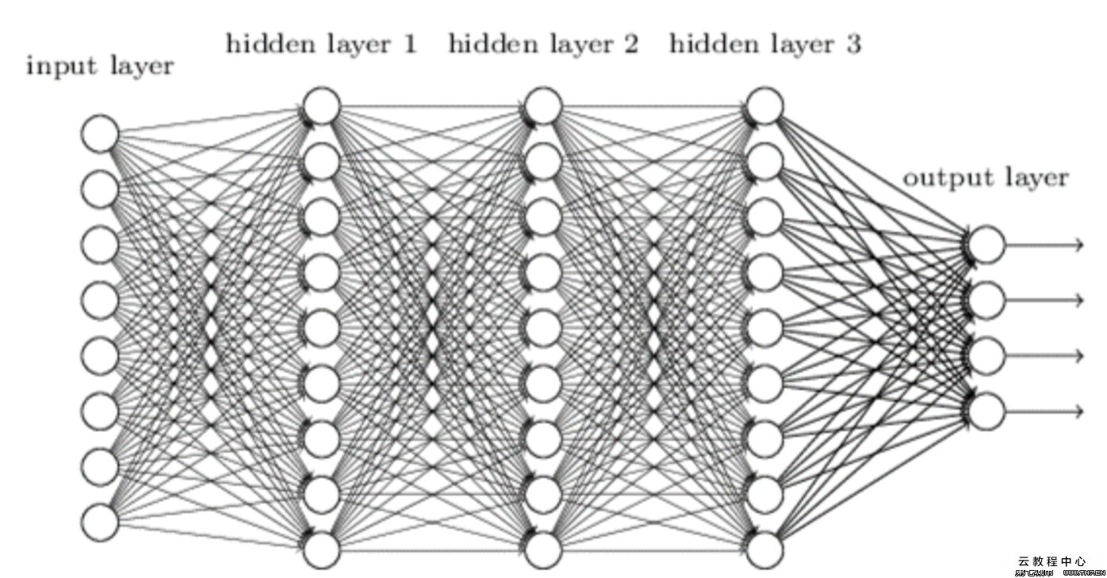
Scenario and Problem
Scenario:
Federated learning in V2X Side-link
Model aggregation: global model
Federated Learning
Local model uploading
Local model uploading
Sidelink communication
Local model uploading
Local model
Local model
Local model

Slide 6




Scenario and Problem
Problem:
1. Different environment results in heterogeneity of dataset for devices, leading to the degradation of FL performance. (This is even worse when deep reinforcement learning is applied, e.g. Use cases in Page)
Federated Training
Federated Training
Model
Model
Model
Model
Probability distribution of channel state
Probability distribution of channel state
Probability distribution of channel state
Probability distribution of channel state
$$P_{1}=[p_{1}\left(h_{1}\right)\text{,…,}p_{1}\left(h_{w}\right)\text{]}$$
$$P_{3}=[p_{3}\left(h_{1}\right)\text{,…,}p_{3}\left(h_{w}\right)\text{]}$$
$$P_{1}=[p_{1}\left(h_{1}\right)\text{,…,}p_{1}\left(h_{w}\right)\text{]}$$
$$P_{2}=[p_{2}\left(h_{1}\right)\text{,…,}p_{2}\left(h_{w}\right)\text{]}$$
environment 1
environment 3
environment 1
environment 2
Less Similar environment: Bad
More Similar environment: Good
2. Straggler effect: everyone waits for the slowest vehicles to update the model.

Slide 7


Solution
Grouping & UE selection
Solve the problem of data heterogeneity: choose similar environment
New signaling content to add in MeasResultsSL (TS 38.331)
i –th Vehicle UE
gNB
Upload the samples of S: $[S_{1},S_{2}$,…, $S_{N}$]
Measure the similarity between DRL models based on $[S_{1},S_{2}$,…, $S_{N}$].
Gather sidelink information, S
(2) Group DRL models with high similarity.
Note:
1. S is the sidelink information, which could be the channel busy ratio (already existed), RSRP, RSRQ, RSSI, SNR, CSI, NLOS/LOS), etc. We specifically add the probability distribution of channel state as the new content. Details are given in the following slides
2. There are many measurements for the similarity, such as KL divergence (given in P25), etc.

Slide 8
Solution
MeasResultsSL information element
MeasResultsSL-r16 ::= SEQUENCE {
measResultsListSL-r16 CHOICE {
measResultNR-SL-r16 MeasResultNR-SL-r16,
...
},
...
}
MeasResultNR-SL-r16 ::= SEQUENCE {
measResultListCBR-NR-r16 SEQUENCE (SIZE (1.. maxNrofSL-PoolToMeasureNR-r16)) OF MeasResultCBR-NR-r16,
measResultListPDCS-NR SEQUENCE (XXXXX)
measResultListOther-NR SEQUENCE (XXXXX)
...
}
Add new signaling “measResultListPDCS-NR” in MeasResultsSL to transmit the probability distribution of channel state $P_{i}=[p_{i}\left(h_{1}\right),p_{i}\left(h_{2}\right)$,…,$p_{i}\left(h_{w}\right)$] in sidelink i, where $p_{i}\left(h_{k}\right)$ is the probability that sidelink is in channel state${ h}_{k}.$
Add new signaling “measResultListOther-NR” in MeasResultsSL to transmit other sidelink information such as RSRP, RSRQ, RSSI, SNR, CSI, NLOS/LOS, channel statistics (e.g., mean, variance), etc
The detail of why transmitting the probability distribution of channel state is shown in the following sildes Page 9 and Page 10

Slide 9



















Use case: side-link power control
Scenario: Power Control for Delay-Power Tradeoff
Adaptive Power Control
$$CSI$$
$$P1$$
Channel state $h_{1}$
…
…
$$P2$$
Channel state $h_{2}$
server
…
…
$$a[n]$$
$$s[n]$$
$$q[n]$$
$$PR$$
Channel state $h_{w}$
$$h[n]$$
Network Layer
Data link Layer
Physical
Layer
Channel
State (CSI)
$$\min{{ D}_{ave}}$$
$$\min{{ P}_{ave}}$$
${ D}_{ave}$--- average delay
${ D}_{th}$--- threshold of delay
s.t. $P_{ave}≤P_{th}$
s.t. $D_{ave}≤D_{th}$
${ P}_{ave}$--- average power
${ P}_{th}$--- threshold of power
MDP （Markov Decision Problem)

Slide 10
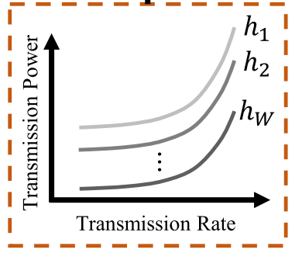
Use case: side-link power control
Solution: Deep Reinforcement Learning based Power Control
Deep Reinforcement Learning（DRL)
Data Arrival
Channel State (CSI)
Power & Rate adaptive
Data Queue
Tx
Rx
Wireless Channel
Environment of DRL
Notes:
Since the optimal power control of sidelink can be formulated as an MDP, we can implement Deep Reinforcement Learning (DRL) to exactly solve MDP, i.e., the optimal power control problem. To achieve better joint training effect, we shall choose similar DRL models as a group to train together. Fortunately, in the sidelink power control problem, the stochastic environment of DRL is wireless channel. Therefore, the probability distribution of channel state can uniquely identify the characteristics of DRL model. We can describe the similarity of DRL models using the similarity of the probability distributions of the channel states. As a result, the probability distribution of channel state is essential for choosing the similar DRL models as the grouping process in FL.

Slide 11
Solution
FL Resource Allocation
Mitigate the straggler effect
i –th Vehicle UE
gNB
Upload A
According to the assistance information uploaded by UE, gNB allocates resources for UEs’ local modal uploading e.g., find the heavy-weighted straggler (slow but significant) and allocate more resource.
Gather assistance information, A
Note:
1. A is the assistance information. In addition to the local information, it contains more information: computational capability (e.g. CPU occupancy), training data size, etc.
2. Heavy-weighted straggler: UE that has more weights in the model aggregation process but with slow updating. E.g. an UE with
1). heavy data(i.e., large training data set) --- > contribute more
2). high priority --- > need to participate the training
3). worse CPUs --- > computation latency
4). located far --- > transmission delay.
3. gNB has to allocate more resources to the “straggler” vehicle to reduce its transmission latency

Slide 12


Solution
FL Process
i –th Vehicle UE
gNB
Upload the samples of S: $[S_{1},S_{2}$,…, $S_{N}$]
Gather sidelink information, S
Measure the similarity between DRL models based on $[S_{1},S_{2}$,…, $S_{N}$].
Global model
(2) Group DRL models with high similarity.
Gather assistance information, A
Training based on the basic model
Upload A
According to the assistance information uploaded by UE, gNB allocates resources for UEs’ local modal uploading e.g., find the heavy-weighted straggler (slow but significant) and allocate more resource.
Resource allocation information
gNB aggregates the local models to get the global model.
Upload the local model

Slide 13
Summary
To solve the problem of data heterogeneity, a proper selection of UE is required in FL. The side-link information of the probability distribution of channel state is uploaded to the gNB as the basis for FL UE-vehicle selection. The transmission is done via the uplink. Although the uplink transmission of sidelink information is supported in R16. Therefore new signaling is introduced.
The straggler effect is a problem exclusively in FL. To mitigate it, resource allocation is applied to reduce the transmission latency of the straggler. This process involves uploading some assistance information as new signalings (e.g. CPU occupany, training data size, etc)

Slide 14





Use case: side-link power control
Solution: Joint Training of DRL Model through Federated Learning
(1) Training in Single DRL Model
DRL Model
Updating of Queue Length
Reward
Transmission Power
Action
Power Consumption
Probability distribution of channel state
$[p\left(h_{1}\right),p\left(h_{2}\right)$,…,$p\left(h_{w}\right)$]
environment
(2) Federated Training in Multi DRL Models
Different environment results in heterogeneity of dataset for devices, leading to the degradation of FL performance.
Federated Training
Federated Training
DRL Model 1
DRL Model 2
DRL Model 1
DRL Model 2
Probability distribution of channel state
Probability distribution of channel state
Probability distribution of channel state
Probability distribution of channel state
$[p\left(h_{1}\right),p\left(h_{2}\right)$,…,$p\left(h_{w}\right)$]
$[p\left(h_{1}\right),p\left(h_{2}\right)$,…,$p\left(h_{w}\right)$]
$[p\left(h_{1}\right),p\left(h_{2}\right)$,…,$p\left(h_{w}\right)$]
$[\check{p}\left(h_{1}\right),\check{p}\left(h_{2}\right)$,…,$\check{p}\left(h_{w}\right)$]
environment 1
environment 1
environment 1
environment 2
Good
Bad

Slide 15
Use case: side-link power control
Model aggregation: global model
Federated Learning
Local model uploading
Local model uploading
Local model uploading
Sidelink power control
Local model:
DRL
Local model:
DRL
Local model:
DRL
Power Control for sidelink
Communication
Power Control for sidelink
Communication
Power Control for sidelink
Communication

Slide 16

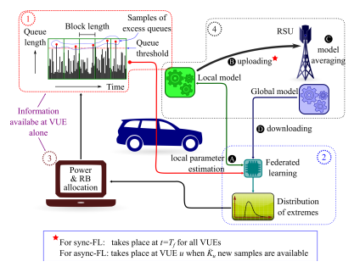
Appendix: Literature Research
FL in Vehicular Networks: Queuing Management in Side-link
V2V Communications in different environments
Queuing Management based on FL
Distributed Federated Learning for Ultra-Reliable Low-Latency Vehicular Communications Sumudu Samarakoon , Member, IEEE,
Mehdi Bennis , Senior Member, IEEE, Walid Saad , Fellow, IEEE, and Mérouane Debbah, Fellow, IEEE

Slide 17
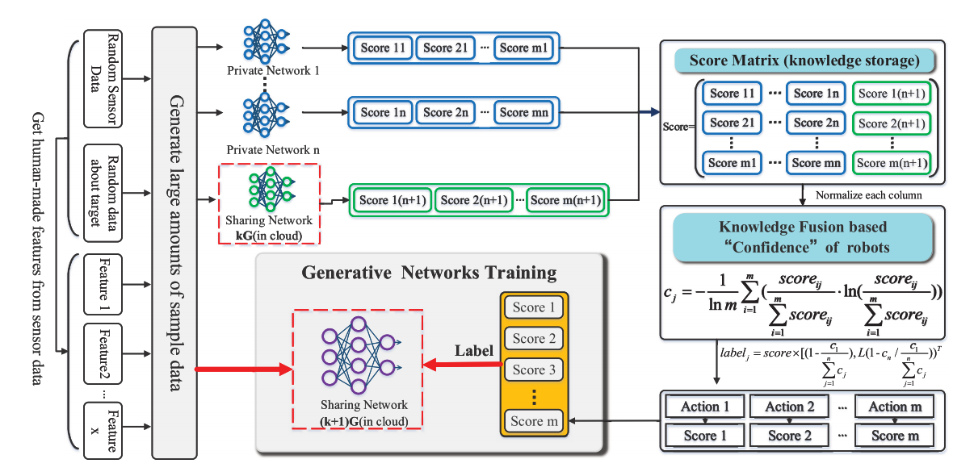
Appendix: Literature Research
Federated Reinforcement Learning (FRL)
Framework: Federated Reinforcement Learning
Liu B, Wang L, Liu M. Lifelong federated reinforcement learning: a learning architecture for navigation in cloud robotic systems[J]. IEEE Robotics and Automation Letters, 2019, 4(4): 4555-4562.

Slide 18
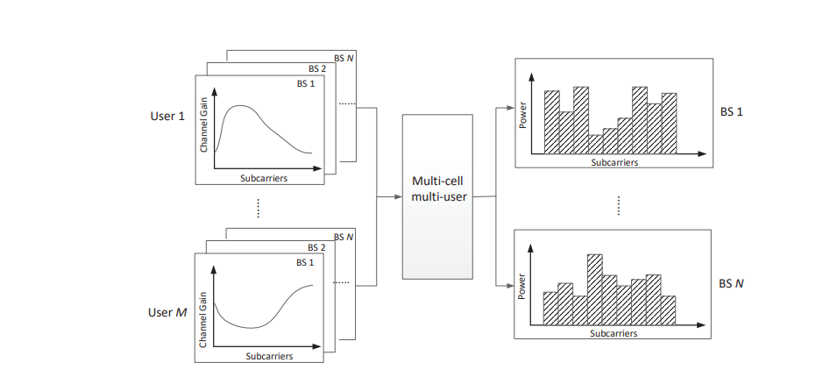
Appendix: Literature Research
Federated Reinforcement Learning (FRL)
Application: Multi-Cell Power Control Problem
Federated Learning for 6G: Applications, Challenges, and Opportunities https://arxiv.org/abs/2101.01338

Slide 19
Appendix: Motivation
In [1], FL was implemented in queuing management of side-link, in which queue-length-bound violation probability was finally minimized
In [2], the concept and framework of FRL were proposed, based on which FL can be used to jointly train multiple DRL models
In [3], the FRL were implemented in Multi-Cell power control problem to maximize the total throughput
Enhance Queuing Management of Side-link through FL
Train multi DRL models together through FL
Implement DRL in power control
We implement DRL in adaptive power control to enhance queuing management of side-link in achieving the optimal delay-power tradeoff. The DRL models can be trained together through FL to speed up the training process and share training samples.
[1] Distributed Federated Learning for Ultra-Reliable Low-Latency Vehicular Communications Sumudu Samarakoon , Member, IEEE,
Mehdi Bennis , Senior Member, IEEE, Walid Saad , Fellow, IEEE, and Mérouane Debbah, Fellow, IEEE
[2] Liu B, Wang L, Liu M. Lifelong federated reinforcement learning: a learning architecture for navigation in cloud robotic systems[J]. IEEE Robotics and Automation Letters, 2019, 4(4): 4555-4562.
[3] Federated Learning for 6G: Applications, Challenges, and Opportunities https://arxiv.org/abs/2101.01338

Slide 20
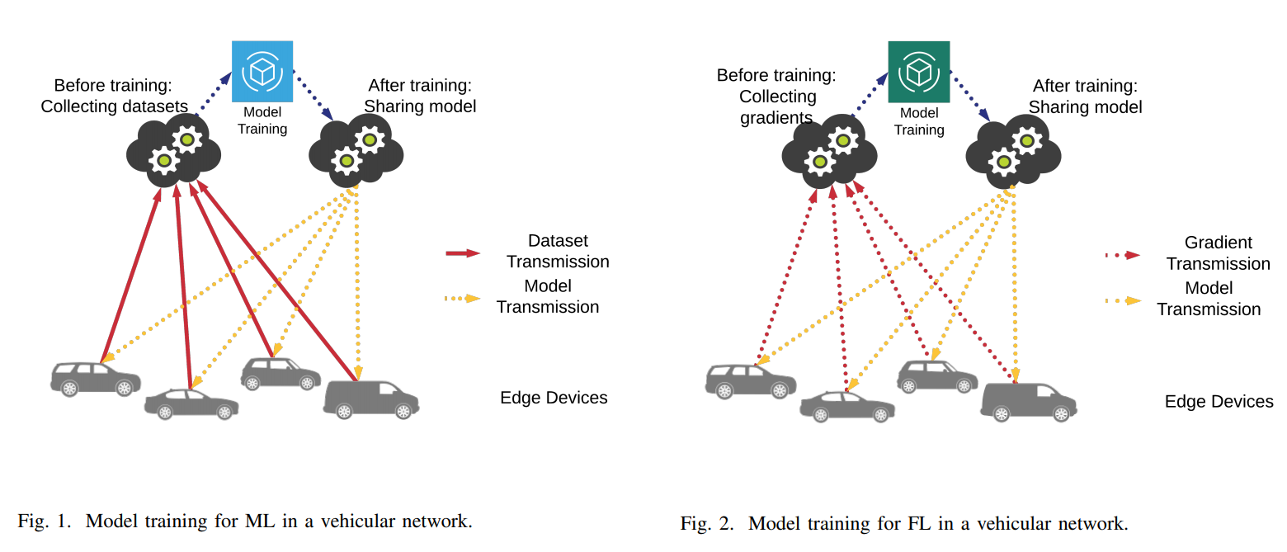
Background
FL in Vehicular Networks: Pros & Cons
Benefits:
Compared with traditional ML training in Vehicular Network, users in FL only need to upload the Local AI model (Gradient) instead of the dataset. This reduces communication overheads and protects privacy and security
Challenges:
1. Efficient model training --- the model quality may be reduced due to aggregation process with the risk of adding irrelevant data samples
2. Scheduling and resource management --- how to mitigate the straggler effect, i.e., in each iteration the aggregation has to wait for the slowest UEs (probably with unfavorable links or limited computational capabilities)
Elbir, Ahmet M., Burak Soner, and Sinem Coleri. "Federated Learning in Vehicular Networks." arXiv preprint arXiv:2006.01412 (2020).

Slide 21

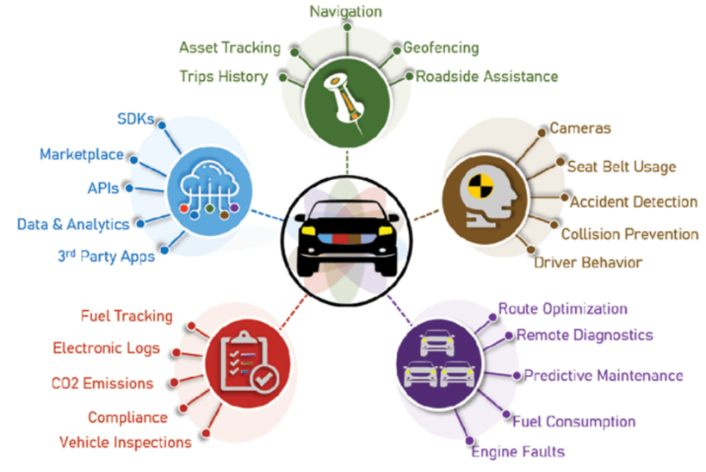
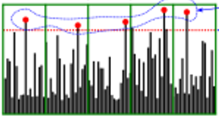

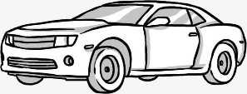
Background
Applying FL in Vehicular Networks
Federated learning (FL) in V2X communications receives more and more attention from academia and industry, due to the large demands for AI model in V2X such as unmanned driving, route optimization, collision prevention and so on. The vehicles that demand the same AI model shall participate in federated learning through wireless communications in order to train an accurate global model.
downloading
Global
model
uploading
Sample data
Local model
AI Training
Power
& resource
allocation
Location
Parameters
uploading
Size of data
& Location
Figure. 1 The demands for AI model in V2X.
Figure. 2 Behaviors of single vehicle in FL.

Slide 22
Background
FL in Vehicular Networks: Motivations
Motivations for FL in Vehicular Networks
Compare with traditional ML training in Vehicular Network, users in FL only need to upload the Local AI model (Gradient) instead of the dataset.
Elbir, Ahmet M., Burak Soner, and Sinem Coleri. "Federated Learning in Vehicular Networks." arXiv preprint arXiv:2006.01412 (2020).

Slide 23
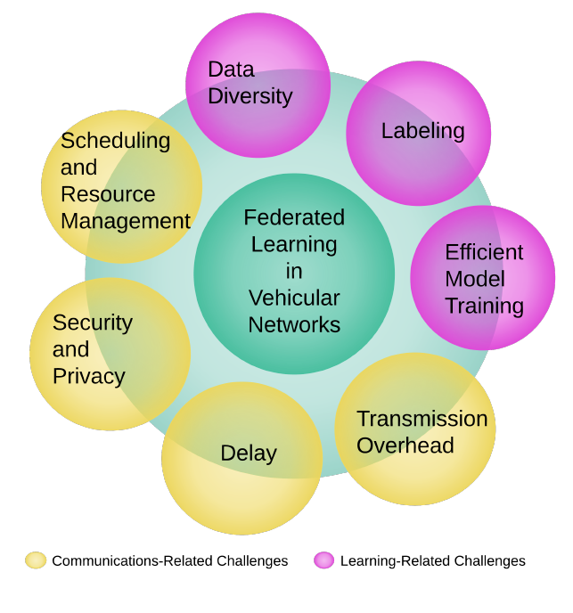
Background
FL in Vehicular Networks：Challenges
Data Diversity
FL-Related
Research Challenges
Labeling
Efficient Model Training
Transmission Overhead
Communications-Related Research Challenges
Delay
Security and Privacy
Scheduling and Resource Management
Elbir, Ahmet M., Burak Soner, and Sinem Coleri. "Federated Learning in Vehicular Networks." arXiv preprint arXiv:2006.01412 (2020).

Slide 24
Background
FL in Vehicular Networks：Challenges
Efficient Model Training
Transfer learning is used to solve the problem of heterogeneous
machine learning model in FL
(2) Transfer learning accuracy strongly relies on the similarity between
the target model and the pre-trained model.
Scheduling and Resource Management
(1) Device heterogeneity and spatial distribution
(2) Frequent and sporadic handovers
Elbir, Ahmet M., Burak Soner, and Sinem Coleri. "Federated Learning in Vehicular Networks." arXiv preprint arXiv:2006.01412 (2020).

Slide 25

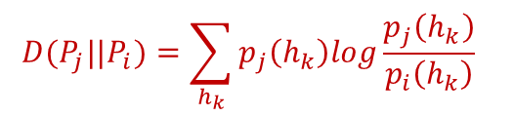
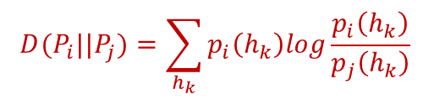

Introduction to KL divergence
What is KL divergence
The KL divergence is an information-theoretic measure introduced by Kullback and Leibler in 1951, and quantifies the discrepancy between two information sources or random variables. The KL divergence plays significant roles in information theory and various disciplines such as statistics, machine learning, physics, neuroscience, computer science, linguistics, etc.
Mathematical form of KL divergence
For two probability distributions,
$P_{i}=[p_{i}\left(h_{1}\right),p_{i}\left(h_{2}\right)$,…,$p_{i}\left(h_{w}\right)$]
$P_{j}=[p_{j}\left(h_{1}\right),p_{j}\left(h_{2}\right)$,…,$p_{j}\left(h_{w}\right)$]
KL divergence between two probability distributions can be represented as
$$D(P_{i}||P_{j})=\sum_{h_{k}}{p_{i}\left(h_{k}\right)log\frac{p_{i}\left(h_{k}\right)}{p_{j}\left(h_{k}\right)}}$$
$$D(P_{j}||P_{i})=\sum_{h_{k}}{p_{j}\left(h_{k}\right)log\frac{p_{j}\left(h_{k}\right)}{p_{i}\left(h_{k}\right)}}$$

Slide 26

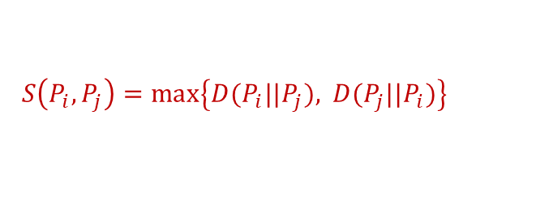

Scenario and Solution
Example for grouping based on probability distribution of CSI in side-link
(1) KL divergence based similarity measurement
Probability distributions of CSI:
$P_{i}=[p_{i}\left(h_{1}\right),p_{i}\left(h_{2}\right)$,…,$p_{i}\left(h_{w}\right)$]
$P_{j}=[p_{j}\left(h_{1}\right),p_{j}\left(h_{2}\right)$,…,$p_{j}\left(h_{w}\right)$]
Similarity measurement based on KL divergence:
$$S\left(P_{i},P_{j}\right)=\max\left\{D(P_{i}||P_{j}), \right.\left. D(P_{j}||P_{i})\right\}$$
(2) FL Grouping based on Similarity Measurement
For probability distributions of CSI: $P_{1}, { P}_{2}, P_{3}$ if $S\left(P_{1},P_{2}\right)≤S\left(P_{1},P_{3}\right)$ then
Federated Training
Federated Training
DRL Model 1
DRL Model 2
DRL Model 1
DRL Model 2
Probability distribution of channel state
Probability distribution of channel state
Probability distribution of channel state
Probability distribution of channel state
$$P_{1}=[p_{1}\left(h_{1}\right)\text{,…,}p_{1}\left(h_{w}\right)\text{]}$$
$$P_{3}=[p_{3}\left(h_{1}\right)\text{,…,}p_{3}\left(h_{w}\right)\text{]}$$
$$P_{1}=[p_{1}\left(h_{1}\right)\text{,…,}p_{1}\left(h_{w}\right)\text{]}$$
$$P_{2}=[p_{2}\left(h_{1}\right)\text{,…,}p_{2}\left(h_{w}\right)\text{]}$$
environment 1
environment 3
environment 1
environment 2
Less Similar environment: Bad
More Similar environment: Good

